Slide 1
Safety management systems
(Student’s Name)

Slide 2

Hazardous material transportation in aviation

Slide 3
Introduction
There are multiple hazardous wastes that are transported via plane.
This implies the larking danger of accidents like spillage or even an explosion.
Plane crashes or explosions are extremely fatal and therefore have to be avoided at all cost.

Slide 4
To avoid the occurrence of these accidents, there are precautionary measures to be taken. These are:
Effective rules and regulations for the cabin crew.
The crew must follow the strict enforced rules to the later, however simple or little. This is to ensure no room for excuses in case of an accident. It’s alo to ensure the safety of the crew.
2) Emergency Response Guide

Slide 5
This is a guidebook with all the emergency precautions for an emergency that must always be on the plane. This is incase a member of the crew wants to refer or confirm a certain procedure or measure. Also they can use it to keep reminding themselves what is expected of them during cargo transit.
The guidebook should also indicate reasons for all measures so the crew is aware with what they are dealing with.

Slide 6
3) Employee training
The employees on the planes must undergo mandatory training. This gives them knowledge to handle all possible kinds of waste. They also understand the various parts of the planes these wastes cannot come into contact with, and why. Employees are also equipped with enough knowledge on what measures to take in case of an accident.

Slide 7
4) Identification of the material and their expected reaction levels.
If reactive, the material should be indicated as so, and to what. There should also be the anticipated reaction based on all the possible reactants.
This helps the crew know how to manage all possible situations in the case of accidents. It also helps them with their preparedness as they board the plane, they know what to carry, and the amounts, numbers or sizes.

Slide 8
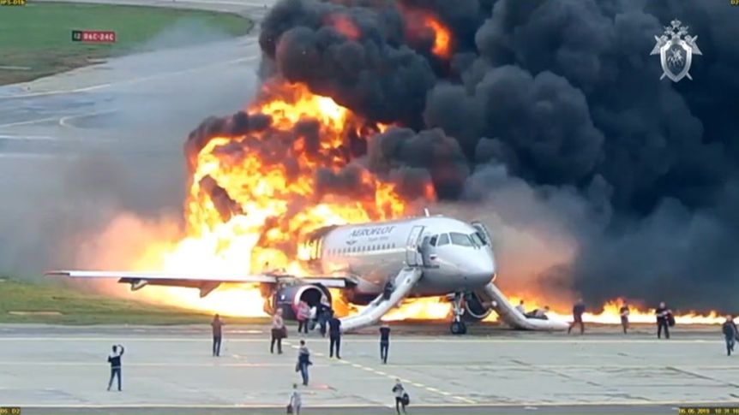
Such is an accident that poor handling of hazardous waste in aviation can bring about.

Slide 9
5) Proper packaging
The material being transported has to be packaged appropriately for transport. some material would require to be wrapped up in foil paper, others in plastic bags or cans, others in metallic material or others glass. These are key details to be observed as they ease carriage, and prevent mixing of different substances in the cargo.

Slide 10
Separation of material can also be by carrying the material on different planes if necessary to avoid fatal risks.
Aviation accidents have a high numbers of fatalities and therefore any risks however small should not be allowed.

Slide 11
References
Ak, R., Bahrami, M., & Bozkaya, B. (2020). A time-based model and GIS framework for assessing hazardous materials transportation risk in urban areas. Journal of Transport & Health, 19, 100943.
Aside, S., No, S., To, S. O., & Due, O. (2020). US Department of Transportation Federal Aviation Administration Request for Offers (RFO) Solicitation Package.
Kapp, E. A., Wroth, D. S., & Chapin, J. T. (2020). Analysis of thermal runaway incidents involving lithium batteries in US commercial aviation. Transportation research record, 2674(11), 584-592.
Ni, X., Wang, H., Che, C., Hong, J., & Sun, Z. (2019). Civil aviation safety evaluation based on deep belief network and principal component analysis. Safety science, 112, 90-95.
Quanyi, L., Xiaoying, Y., & Xu, H. (2020). Effect of different arrangement on thermal runaway characteristics of 18650 lithium ion batteries under the typical pressure in civil aviation transportation. Fire technology, 56(6), 2509-2523.

